Slide 1
  CARTESIAN PRODUCT ( x )
  DIVISION (÷)

Slide 2
Cartesian product:
The Cartesian product is used to combine each row in one table with each row in the other table. It is also known as a cross product.
It is denoted by X.

Slide 3
Relational Algebra Operations from Set Theory: CARTESIAN PRODUCT
CARTESIAN (or CROSS) PRODUCT Operation
  This operation is used to combine tuples from two relations in a combinatorial fashion.
  Denoted by R(A1, A2, . . ., An) x S(B1, B2, . . ., Bm)
  Result is a relation Q with degree n + m attributes:
■ Q(A1, A2, . . ., An, B1, B2, . . ., Bm), in that order.
  The resulting relation state has one tuple for each combination of tuples—one from R and one from S.
  Hence, if R has n_{R} tuples (denoted as |R| = n_{R} ), and S has n_{S} tuples, then R x S will have n_{R} * n_{S} tuples.
  The two operands do NOT have to be "type compatible”

Slide 4
◻ Generally, CROSS PRODUCT is not a meaningful operation
◉ Can become meaningful when followed by other operations
Example:
  (Π _{FNAME, LNAME, SSN} (σ _{SEX=’F’}(EMPLOYEE))) x DEPENDENT

Slide 5
EMPLOYEE
EM_ID | EMP_NAME | EMP_DEPT
1 | Smith | A
2 | Harry | C
3 | John | B

Slide 6
DEPARTMENT
DEPT_NO | DEPT_NAME
A | Marketing
B | Sales
C | Legal

Slide 7
EMPLOYEE X DEPARTMENT
EMP_ID | EMP_NAME | EMP_DEPT | DEPT_NO | DEPT_NAME
1 | Smith | A | A | Marketing
1 | Smith | A | B | Sales
1 | Smith | A | C | Legal
2 | Harry | C | A | Marketing
2 | Harry | C | B | Sales
2 | Harry | C | C | Legal
3 | John | B | A | Marketing
3 | John | B | B | Sales
3 | John | B | C | Legal

Slide 8
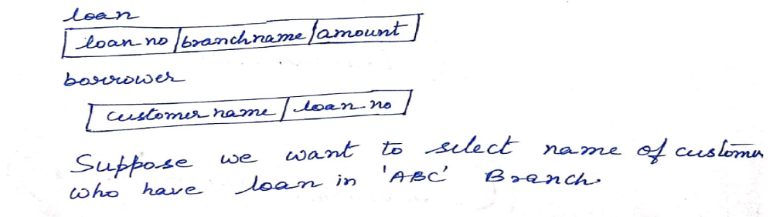
∏CUSTOMER_NAME (σborrower.loan_no=loan.loan_no ((σbranchname=‘ABC’(Loan)) X Borrower))

Slide 9
To keep only combinations where the DEPENDENT is related to the EMPLOYEE, we add a SELECT operation as follows
Example (meaningful):
FEMALE_EMPS ← σ _{SEX=’F’}(EMPLOYEE)
EMPNAMES ← Π _{FNAME, LNAME, SSN} (FEMALE_EMPS)
EMP_DEPENDENTS ← EMPNAMES x DEPENDENT
ACTUAL_DEPS ← σ _{SSN=ESSN}(EMP_DEPENDENTS)
^{RESULT} ← Π FNAME, LNAME, DEPENDENT_NAME ^{(ACTUAL_DEPS)}
◻ RESULT will now contain the name of female employees and their dependents

Slide 10
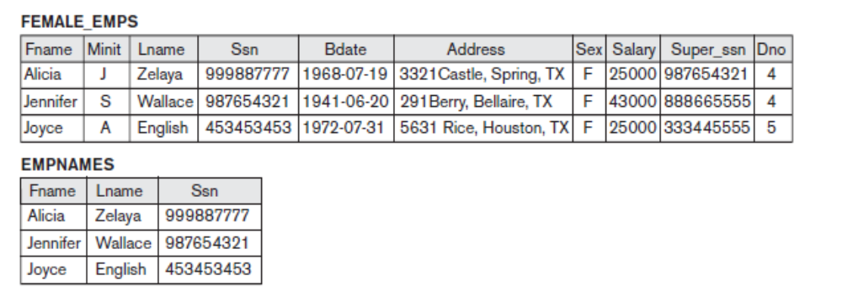

Slide 11
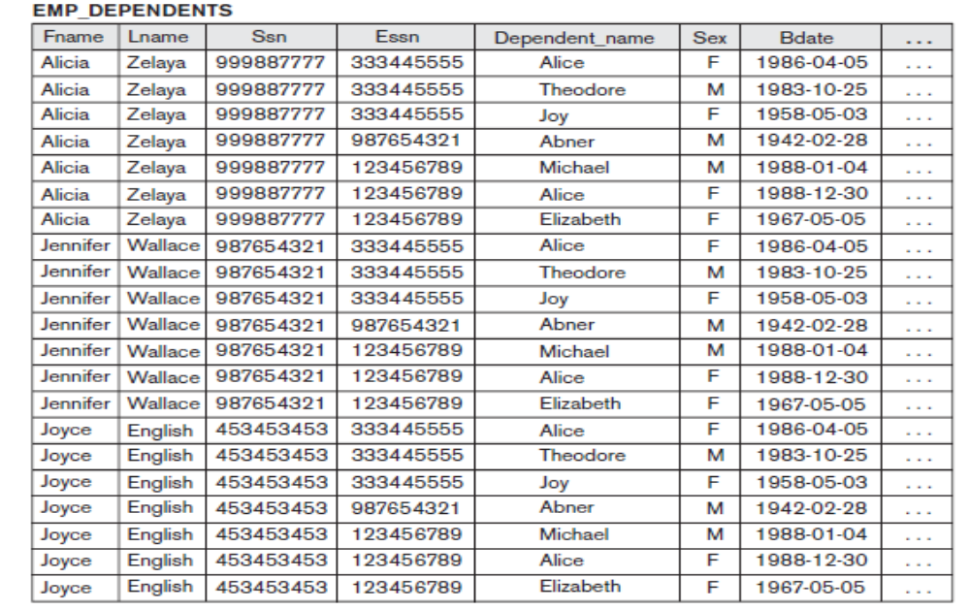

Slide 12
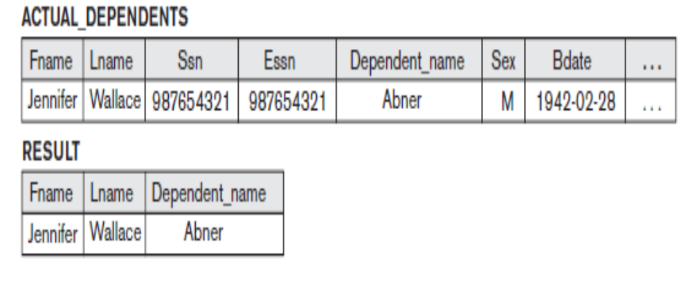

Slide 13
Division Operator (÷):
Division operator A÷B can be applied if and only if:
Attributes of B is proper subset of Attributes of A.
The relation returned by division operator will have attributes = (All attributes of A – All Attributes of B)
The relation returned by division operator will return those tuples from relation A which are associated to every B’s tuple.

Slide 14
STUDENT_SPORTS
ROLL_NO | SPORTS
1 | Badminton
2 | Cricket
2 | Badminton
4 | Badminton
STUDENT_SPORTS

Slide 15
ALL_SPORTS
SPORTS
Badminton
Cricket

Slide 16
STUDENT_SPORTS÷ ALL_SPORTS
The operation is valid as attributes in ALL_SPORTS is a proper subset of attributes in STUDENT_SPORTS.
The attributes in resulting relation will have attributes {ROLL_NO,SPORTS}-{SPORTS}=ROLL_NO
The tuples in resulting relation will have those ROLL_NO which are associated with all B’s tuple {Badminton, Cricket}. ROLL_NO 1 and 4 are associated to Badminton only. ROLL_NO 2 is associated to all tuples of B. So the resulting relation will be:
ROLL_NO
2

Slide 17
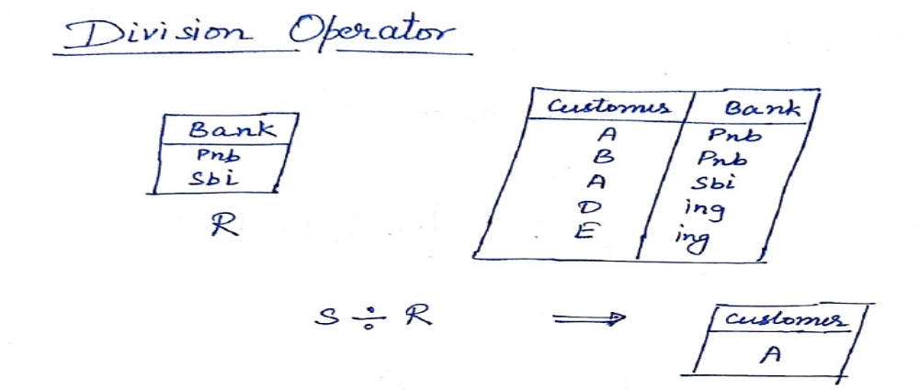
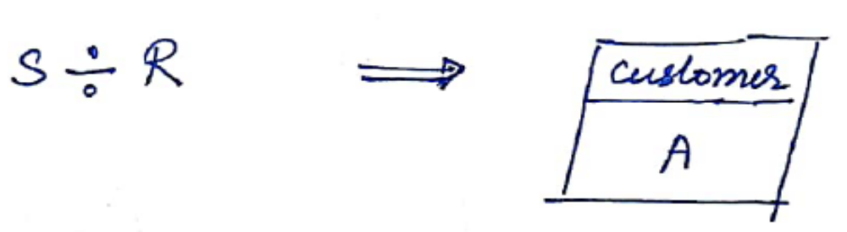

Slide 18
Thank
You

